Slide 1
&
Inverness Disaster Council
Preparing for Wildfire

Slide 2
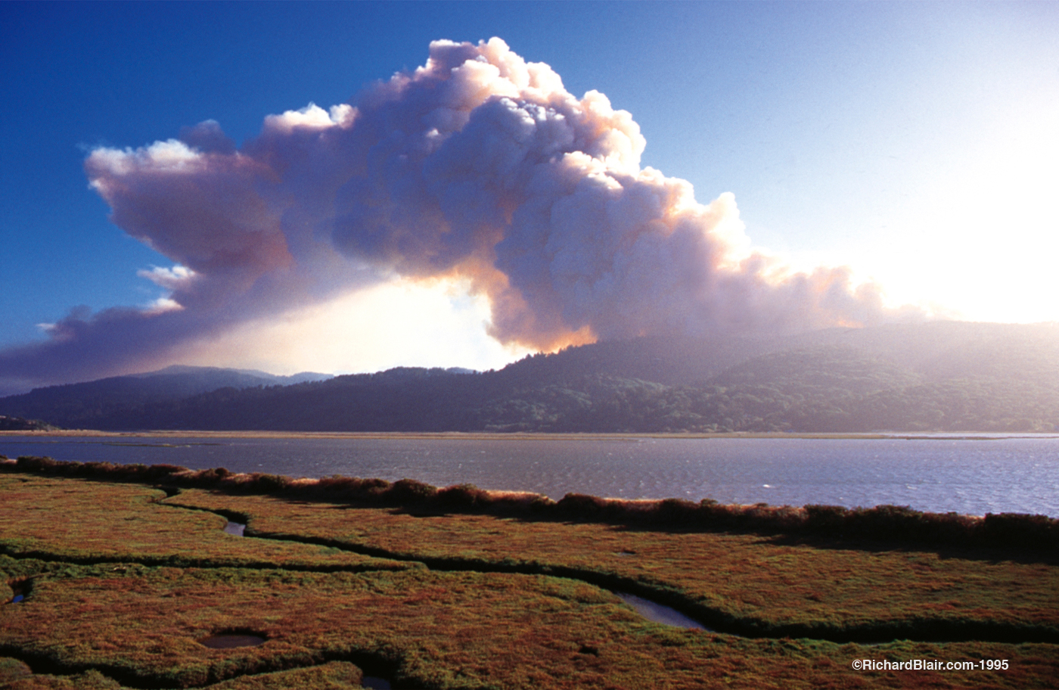
Vision Fire
1995
Vision Fire
1995

Slide 4
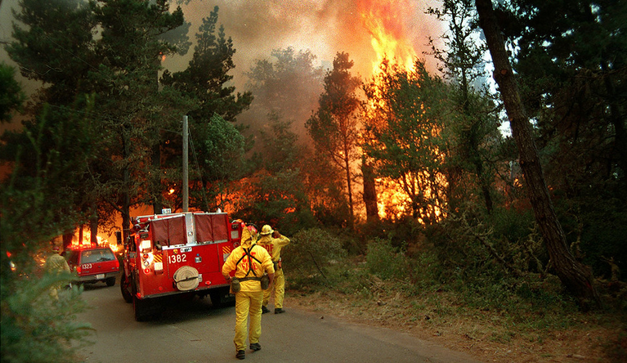

Slide 5
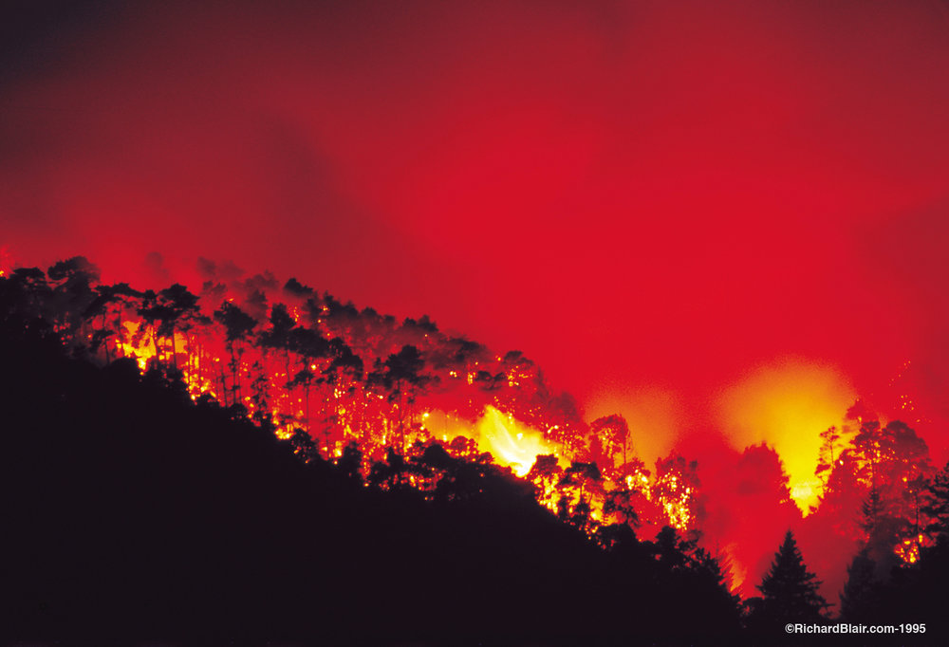

Slide 6
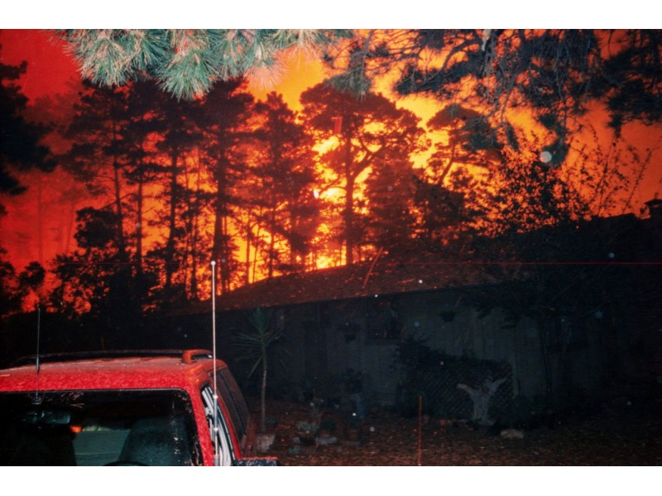

Slide 7
The Vision Fire burned 12,354 acres,
destroyed 45 structures,
and caused
$23 million in damage

Slide 8
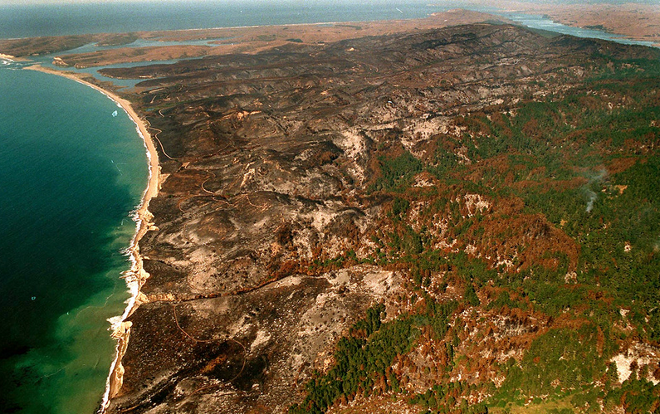

Slide 9
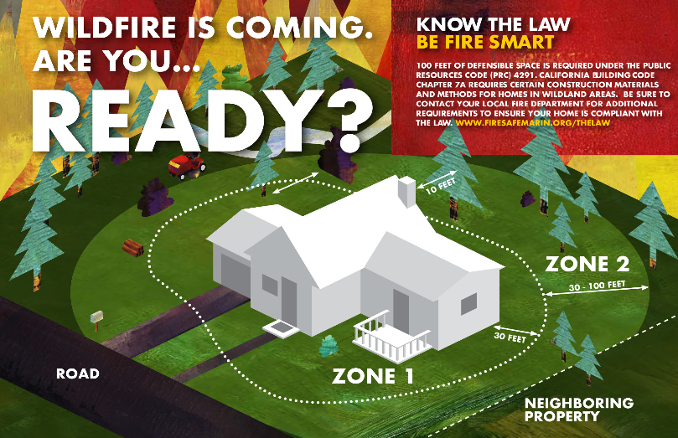

Slide 10
Know Your Zones

Slide 11
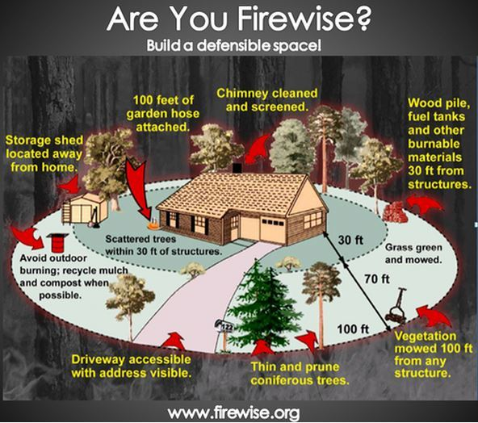

Slide 12
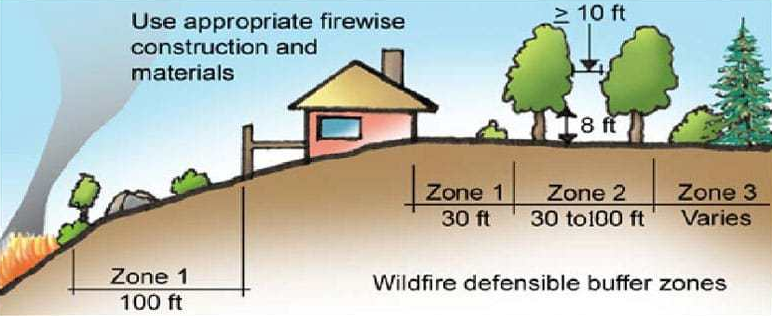

Slide 14
During a Wildfire
Flying embers that lodge in woodpiles, under eves, and in attic spaces can quickly destroy a home.
Embers can spark a structure fire even if the main fire is some distance away from a home.
Don't assume firefighters will be able to protect your home.
Firefighting equipment and personnel will be spread very thin during a large fire.
Evacuate sooner rather than later. Do not wait for emergency personnel to knock on your door tell you to leave.
Have at least two ways out. Follow an evacuation plan drawn up well in advance and practiced periodically.

Slide 15
Evacuation Terminology

Slide 16
Be Ready to Evacuate
Have an family evacuation plan that you’ve practiced
Have an Evacuation Backpack ready
Know what and where the Top 10 Irreplaceable Items are (also known as a Grab-and-Go checklist)
www.readymarin.org

Slide 17
Evacuation Backpack

Slide 18
Resources
www.readyforwildfire.org
www.AlertMarin.org
www.readymarin.org
www.ready.gov/wildfires
www.firesafemarin.org

Slide 19
Inverness Fire Department is available to do defensible space property assessments.
Call for an appointment:
Jim Fox
Chief, IFD
415-669-7151

Slide 20
Thank you and Be Safe

